Slide 1
Welcome to web.lab!
Notes:
1. the lectures will be recorded
2. this is to ensure that people who can't attend lectures have access to course material, and to publish our videos on youtube for the general public to learn web dev
3. the lecture video will be published publicly on youtube
4. the bottom three rows will be visible in the class-wide panopto livestream, and may or may not be visible in the public youtube video

Slide 2
What is web.lab?

Slide 3
What is web.lab?
We teach front-end to back-end full stack web development

Slide 4
What is web.lab?
We teach front-end to back-end full stack web development
We have free lunch with every day of lecture!

Slide 5
What is web.lab?
We teach front-end to back-end full stack web development
We have free lunch with every day of lecture!
We also run a competition throughout IAP with multiple cash prizes

Slide 6
What is web.lab?
We teach front-end to back-end full stack web development
We have free lunch with every day of lecture!
We also run a competition throughout IAP with multiple cash prizes
If you register on WebSIS, we are graded P/D/F and provide 6 units of unrestricted elective credit

Slide 7
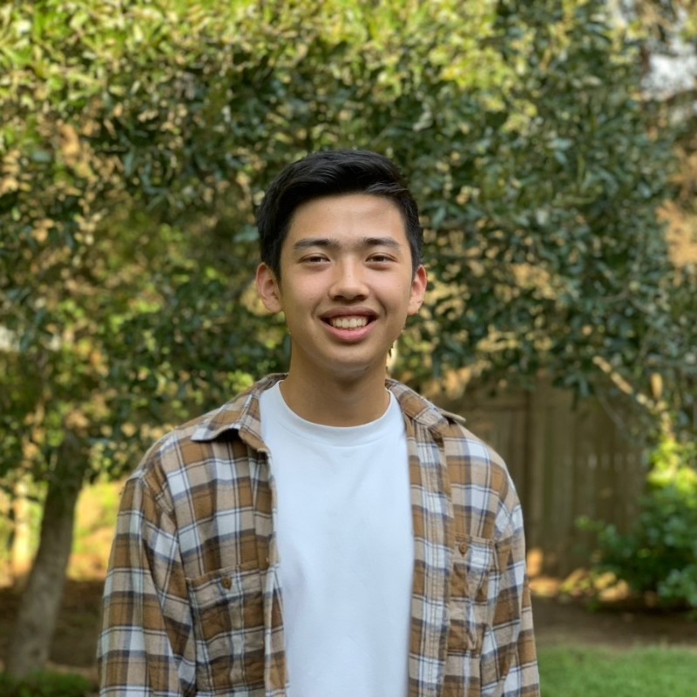
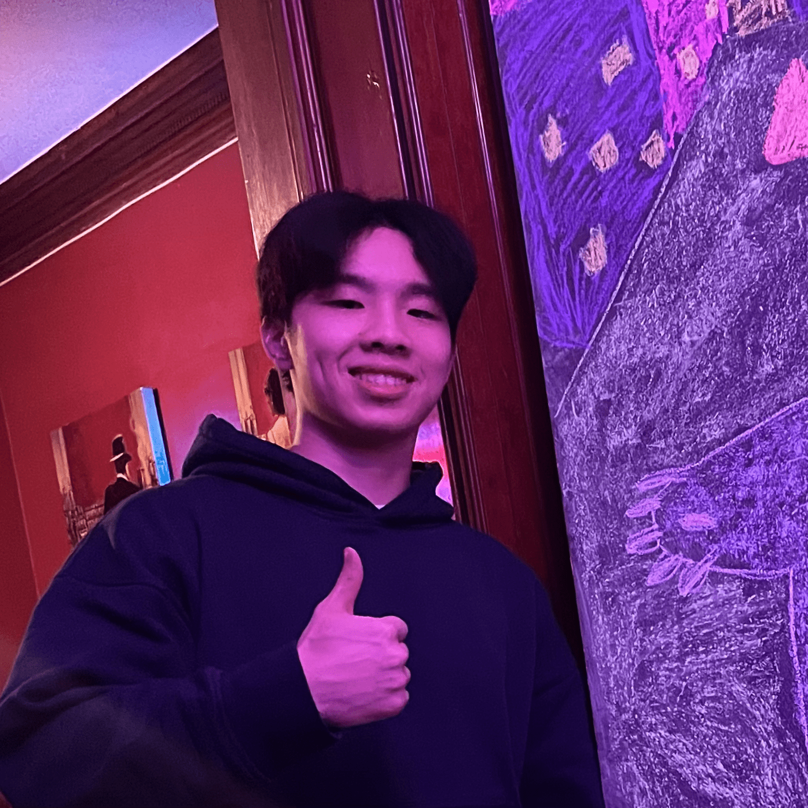
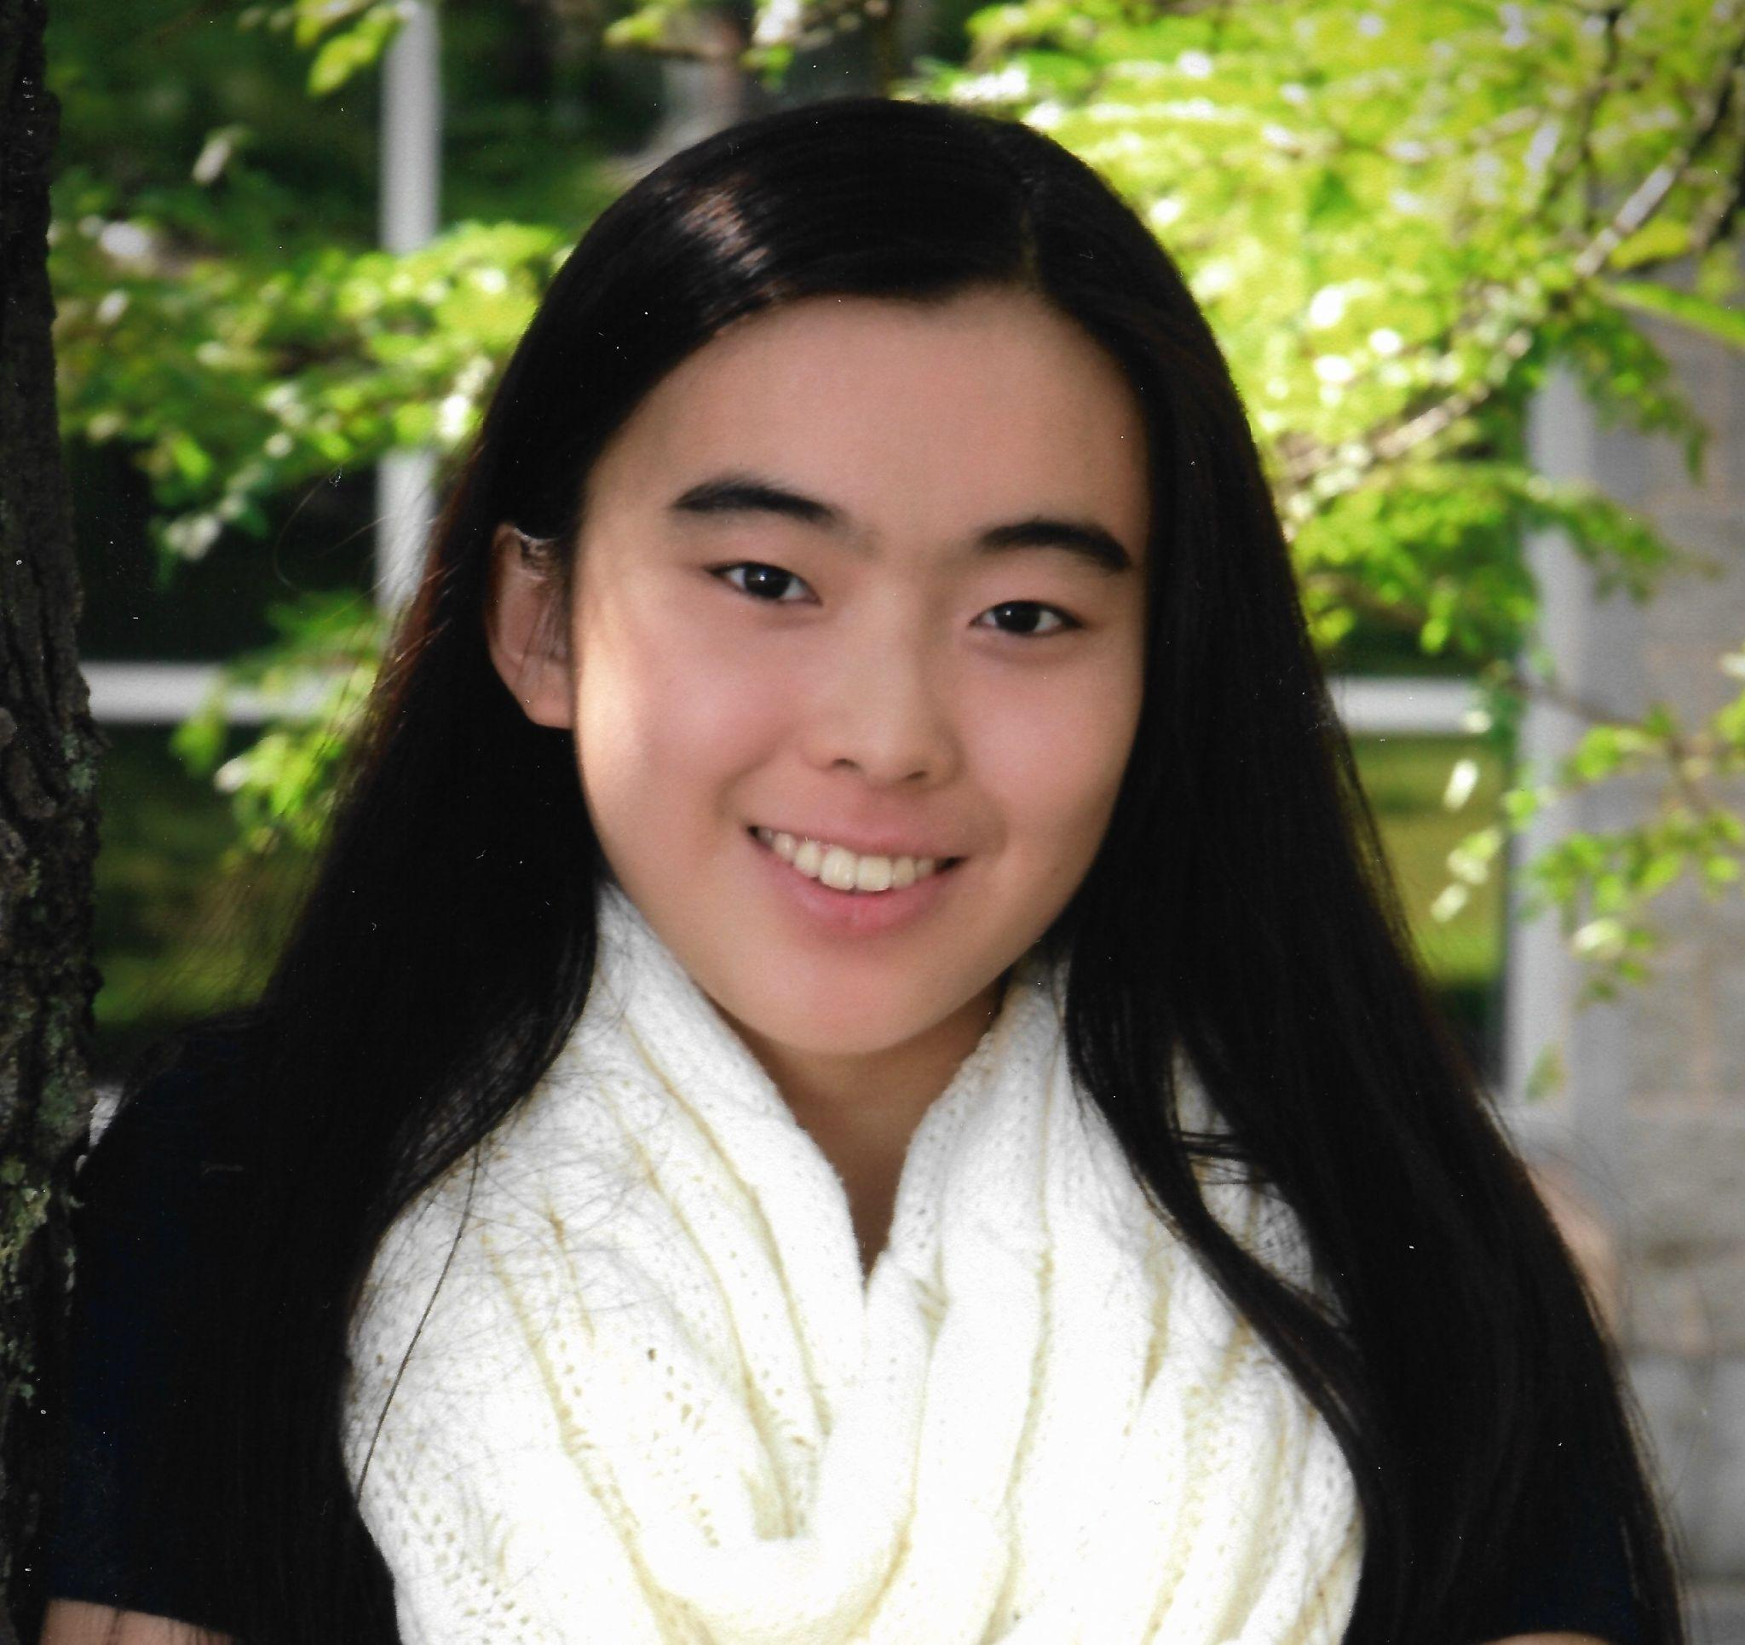

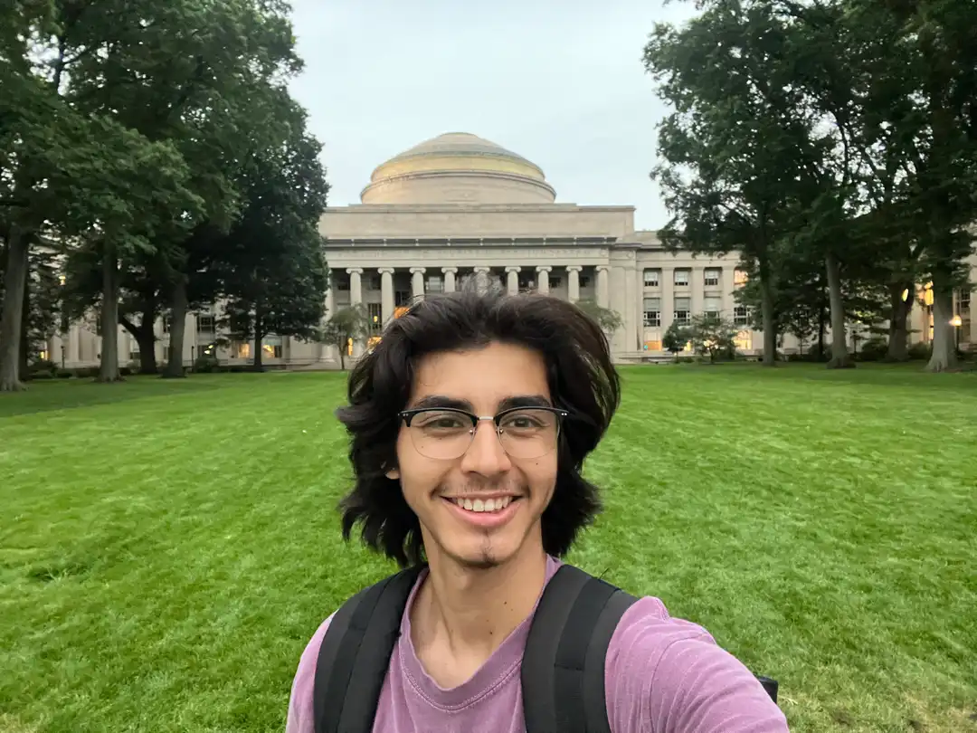
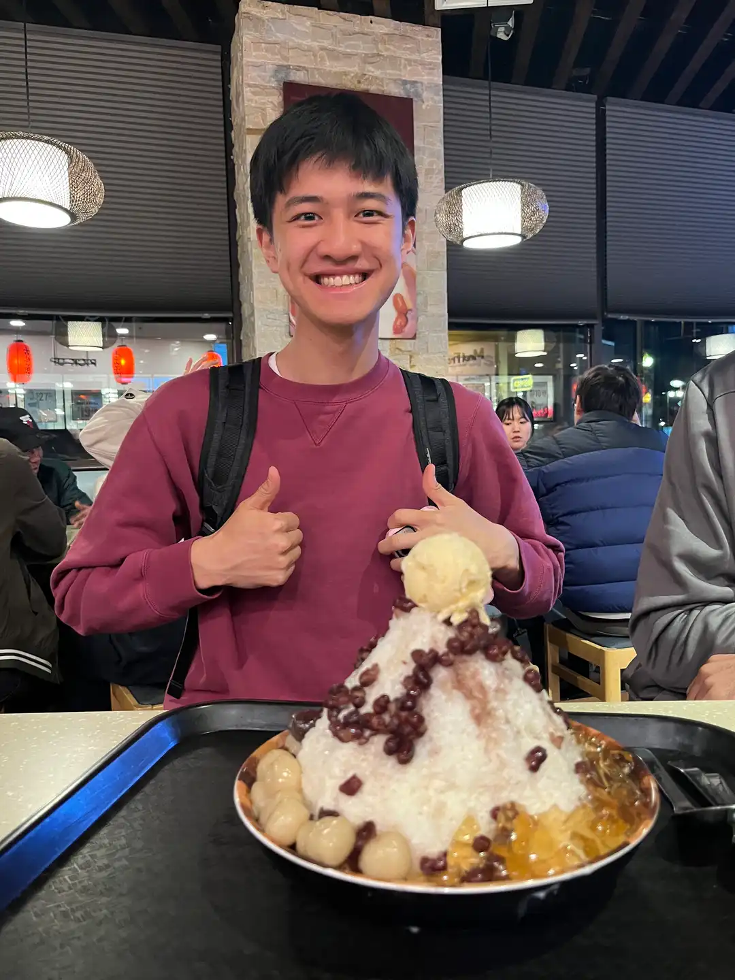
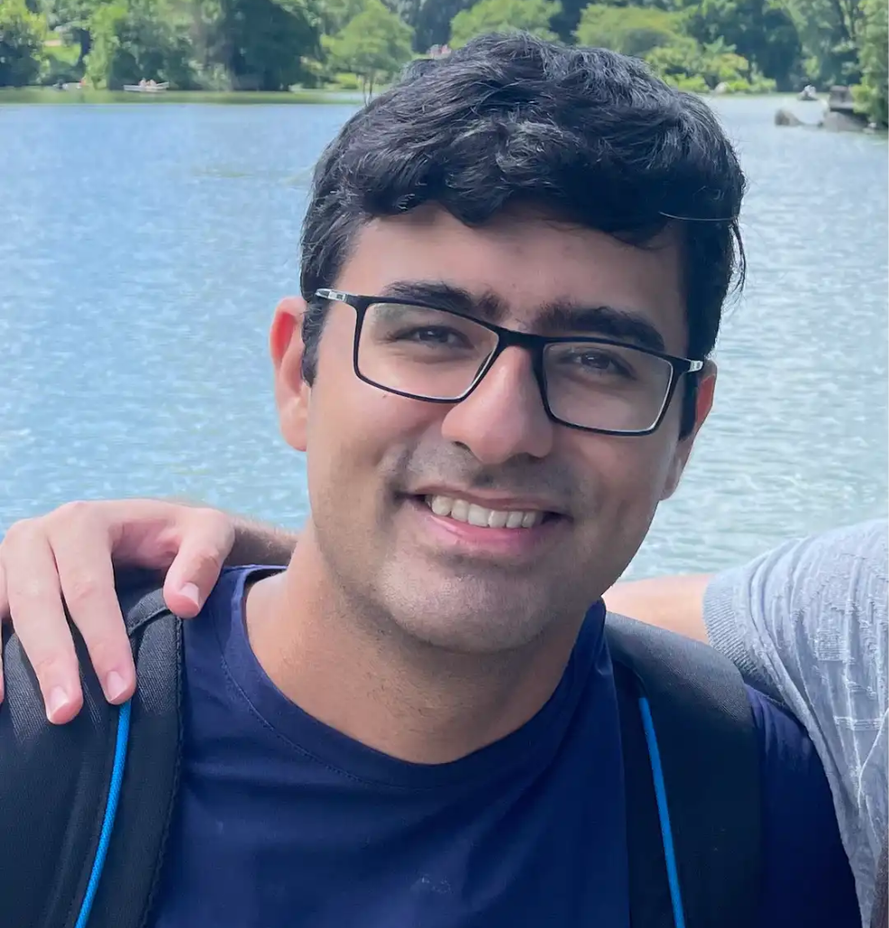
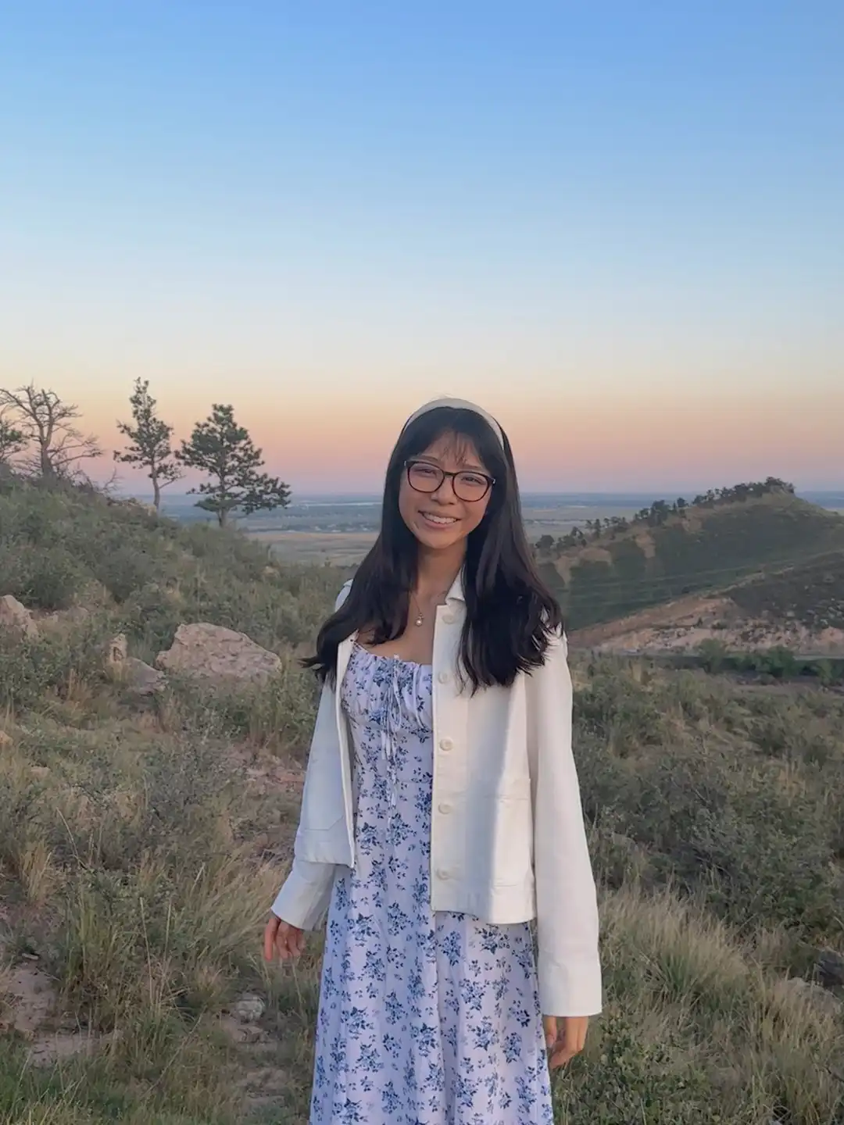

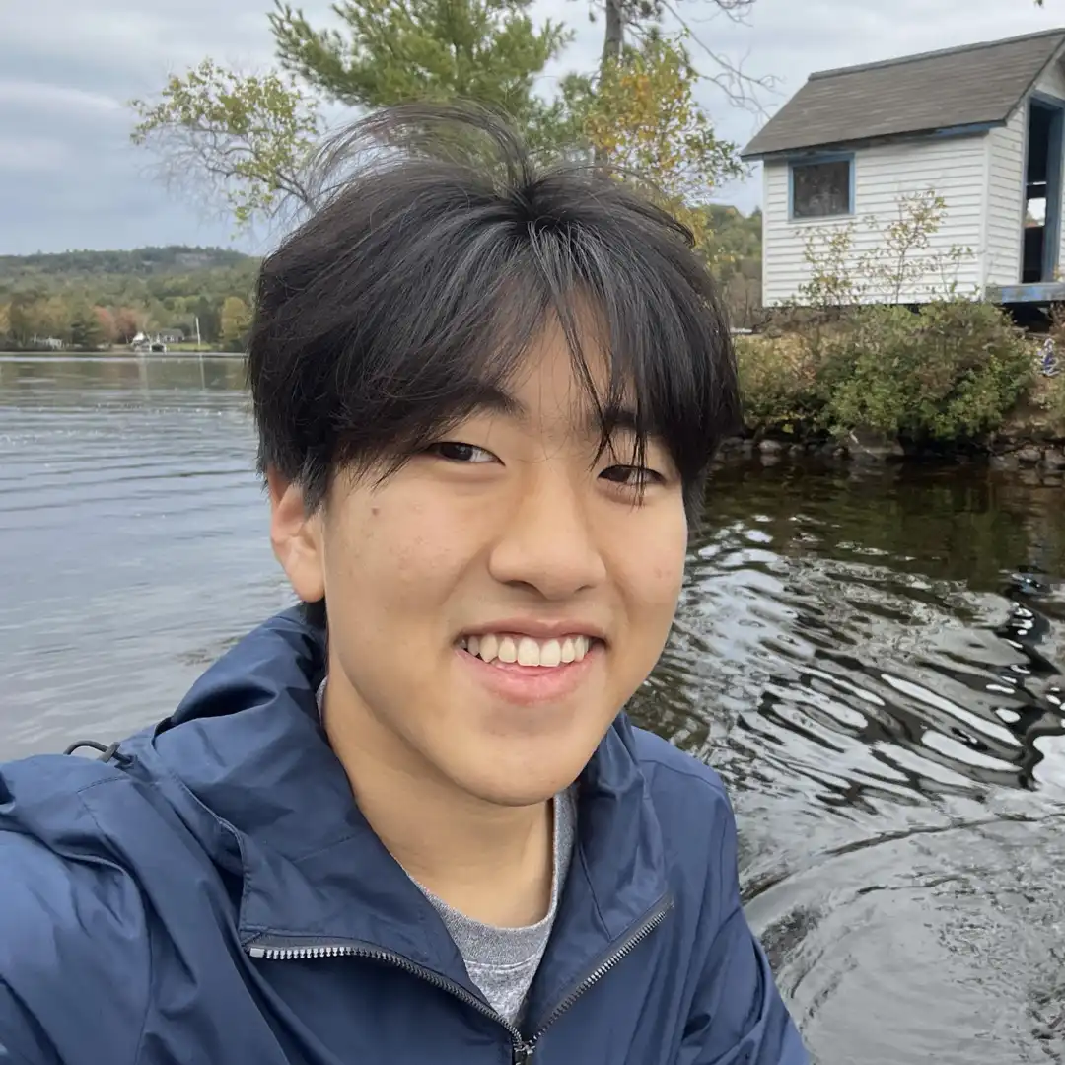
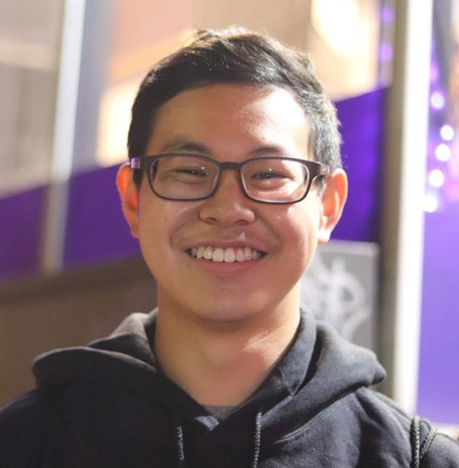
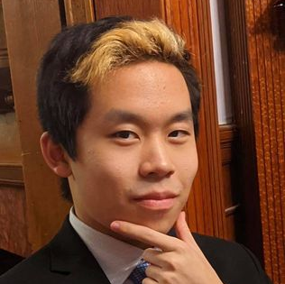
Course Staff!
Andy Jiang
Class of 2026
President
Stanley Zhao
Class of 2027
President
Abby Chou
Class of 2025
Academic Chair
Annabel Tiong
Class of 2027
Operations Chair
Lucas Bautista
Class of 2026
Operations Chair
Daniel Hong
Class of 2025
Tech Chair
David Chaudhari
Class of 2025
Sponsor Chair
Sophie Wang
Class of 2027
Publicity Chair
Samvit Das
Class of 2027
Historian
Evan Kim
Class of 2027
Treasurer
Kenneth Choi
Class of 2025
Eternal Staff
Nicholas Tsao
Class of 2024
Eternal Staff
Notes:
Let me introduce this year’s the course staff
https://weblab.mit.edu/team/

Slide 8
Reminders
Register at weblab.is/portal
If you want credit for the class, you also need to register on websis (6.9620)
Notes:
Our portal is what we’ll be using to send out email communication and where you’ll be submitting your milestones.
We’ll send out a bunch of useful information on Piazza, so make sure to check that.

Slide 9
Reminders
Register at weblab.is/portal
If you want credit for the class, you also need to register on websis (6.9620)
Join the Piazza at weblab.is/piazza
Follow the installation guide immediately!
Notes:
Our portal is what we’ll be using to send out email communication and where you’ll be submitting your milestones.
We’ll send out a bunch of useful information on Piazza, so make sure to check that.

Slide 10
Reminders
Register at weblab.is/portal
If you want credit for the class, you also need to register on websis (6.9620)
Join the Piazza at weblab.is/piazza
Follow the installation guide immediately!
Lectures will be livestreamed and recorded to Youtube. Join the livestream at weblab.is/livestream!*
No, lectures are not mandatory. We don’t take attendance. You get out as much as you put into web.lab
*Today’s lecture is live streamed via Zoom at weblab.is/zoom
Notes:
Our portal is what we’ll be using to send out email communication and where you’ll be submitting your milestones.
We’ll send out a bunch of useful information on Piazza, so make sure to check that.

Slide 11
Logistics

Slide 12
Logistics
No, the competition is not mandatory. But it doesn’t hurt to submit your website into the competition!
Notes:
If you’re confused: Go to the questions doc!
Old questions docs will also get posted on piazza

Slide 13
Logistics
No, the competition is not mandatory. But it doesn’t hurt to submit your website into the competition!
We’ll have live help during workshops where you can add yourself to the queue on weblab.is/q.
Notes:
If you’re confused: Go to the questions doc!
Old questions docs will also get posted on piazza

Slide 14
Logistics
No, the competition is not mandatory. But it doesn’t hurt to submit your website into the competition!
We’ll have live help during workshops where you can add yourself to the queue on weblab.is/q.
You can find the questions doc at weblab.is/questions, where you can ask questions anonymously during class.
Notes:
If you’re confused: Go to the questions doc!
Old questions docs will also get posted on piazza

Slide 15
Logistics
No, the competition is not mandatory. But it doesn’t hurt to submit your website into the competition!
We’ll have live help during workshops where you can add yourself to the queue on weblab.is/q.
You can find the questions doc at weblab.is/questions, where you can ask questions anonymously during class.
You can find the old questions doc at weblab.is/oldquestions
Notes:
If you’re confused: Go to the questions doc!
Old questions docs will also get posted on piazza

Slide 16
Logistics
No, the competition is not mandatory. But it doesn’t hurt to submit your website into the competition!
We’ll have live help during workshops where you can add yourself to the queue on weblab.is/q.
You can find the questions doc at weblab.is/questions, where you can ask questions anonymously during class.
You can find the old questions doc at weblab.is/oldquestions
Student hub for shortlinks is at weblab.is/info
Notes:
If you’re confused: Go to the questions doc!
Old questions docs will also get posted on piazza

Slide 17
Logistics
No, the competition is not mandatory. But it doesn’t hurt to submit your website into the competition!
We’ll have live help during workshops where you can add yourself to the queue on weblab.is/q.
You can find the questions doc at weblab.is/questions, where you can ask questions anonymously during class.
You can find the old questions doc at weblab.is/oldquestions
Student hub for shortlinks is at weblab.is/info
Don’t have a team yet? Stay after lecture today for a team-finding mixer!
Notes:
If you’re confused: Go to the questions doc!
Old questions docs will also get posted on piazza

Slide 18
Course Overview

Slide 19
Schedule

Slide 20
Schedule
Week 1 we build an app from scratch together!

Slide 21
Schedule
Week 1 we build an app from scratch together!
Week 2 add cool features + advanced topics + sponsor lectures

Slide 22
Schedule
Week 1 we build an app from scratch together!
Week 2 add cool features + advanced topics + sponsor lectures
Week 3 code, code, code

Slide 23
Schedule
Week 1 we build an app from scratch together!
Week 2 add cool features + advanced topics + sponsor lectures
Week 3 code, code, code
Week 4 CODE, CODE, CODE final submission, judging, awards!
weblab.mit.edu/schedule

Slide 24
We take you end-to-end

Slide 25
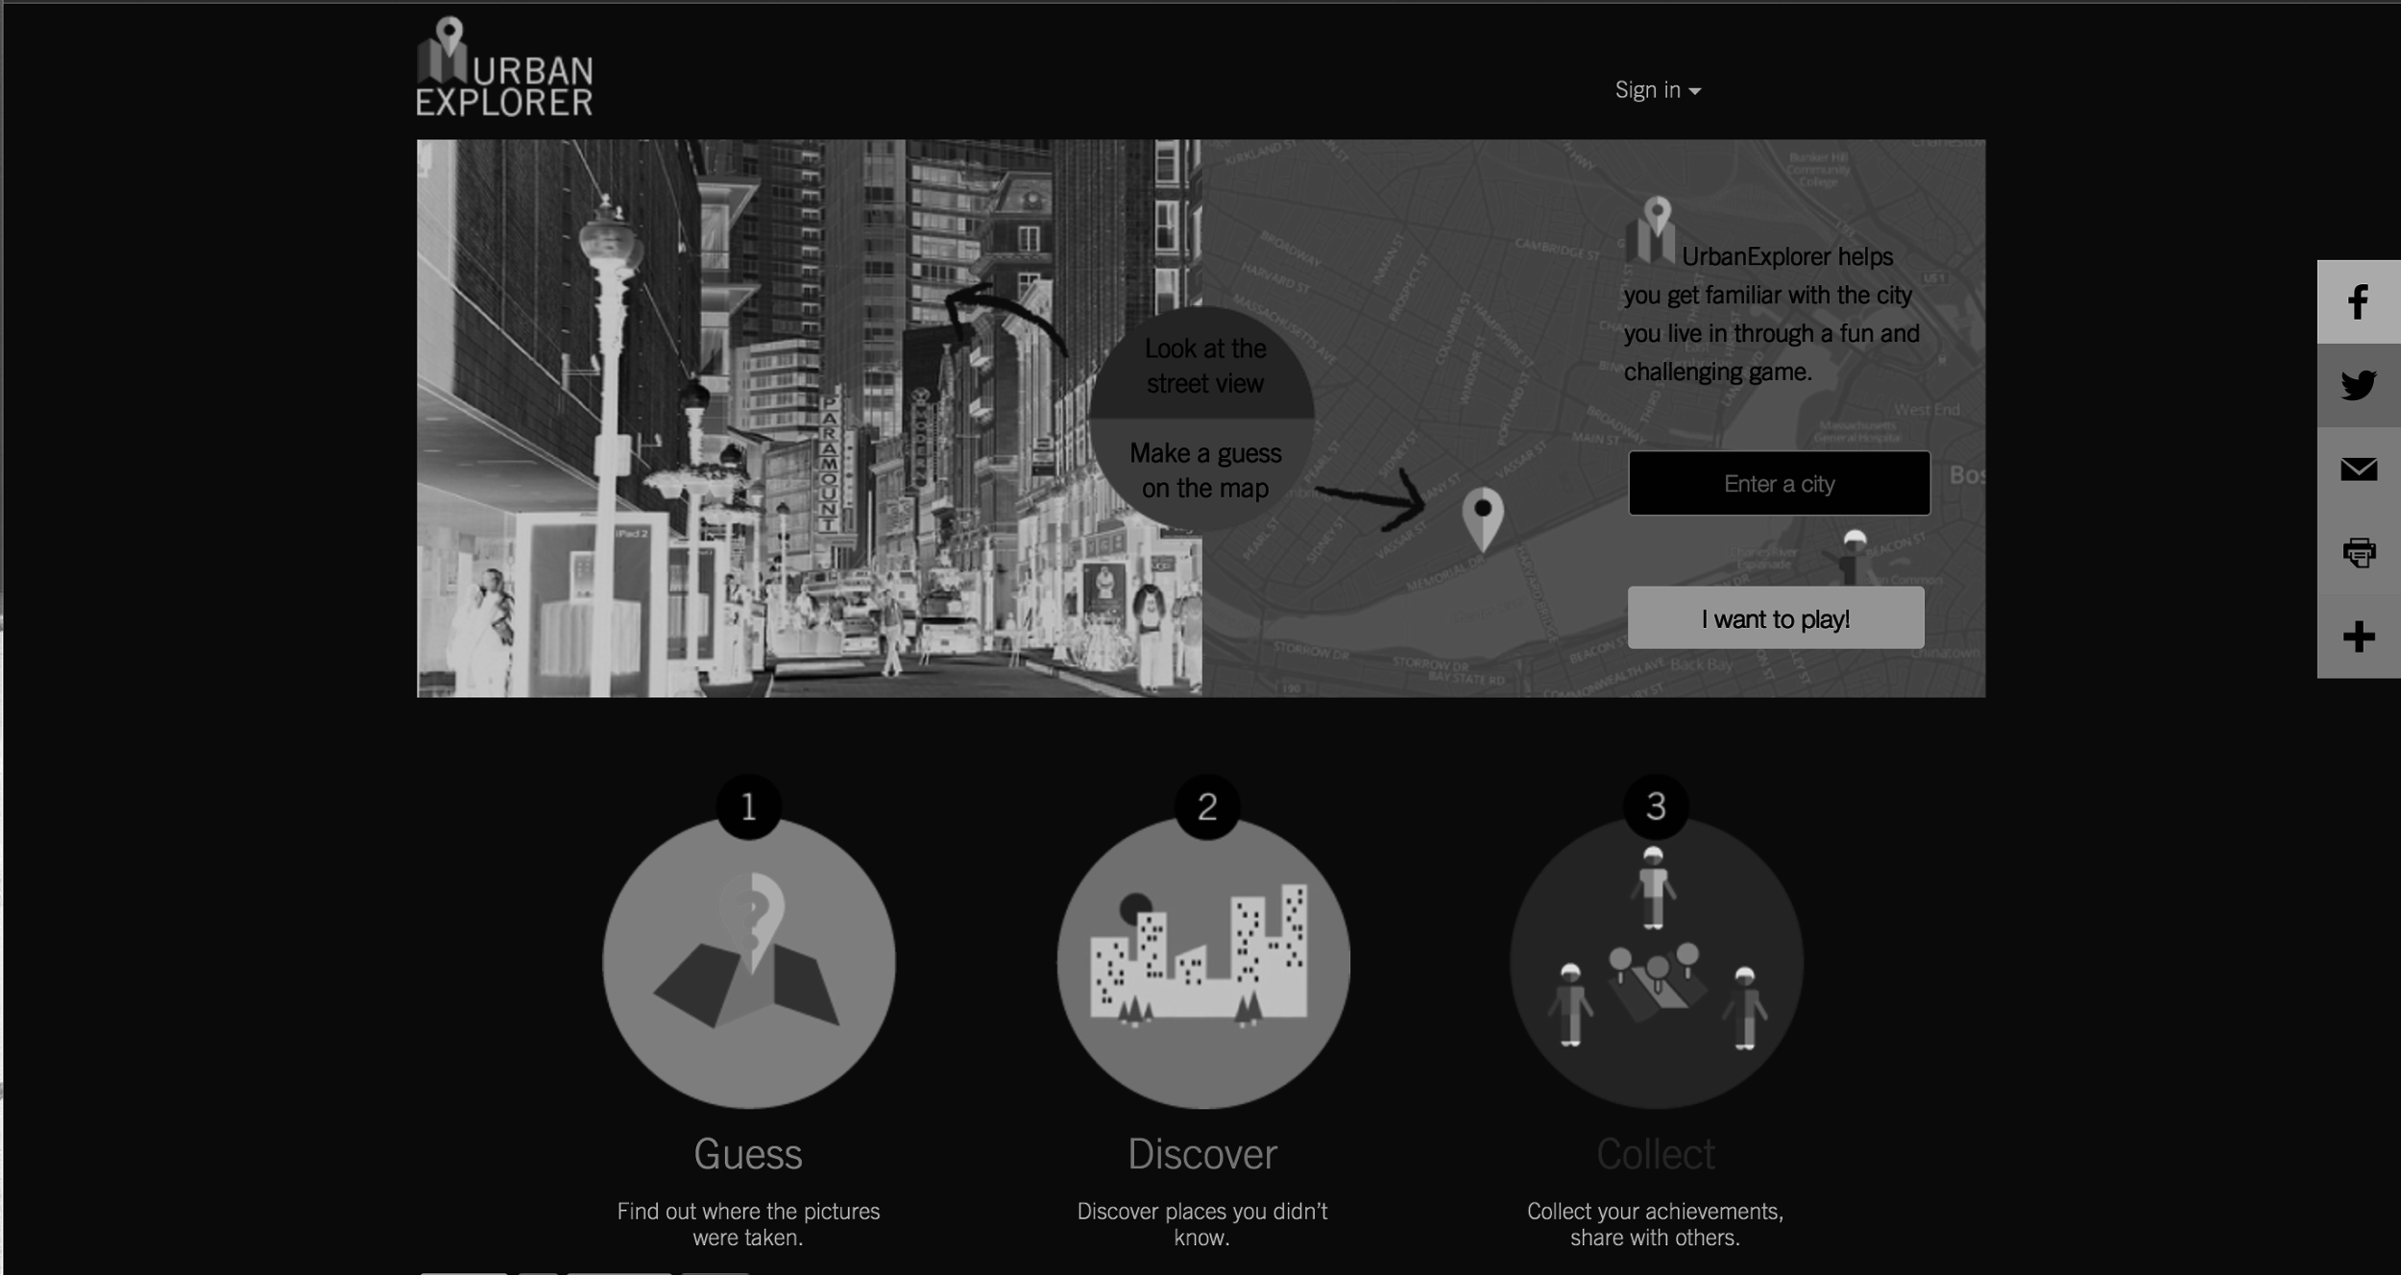
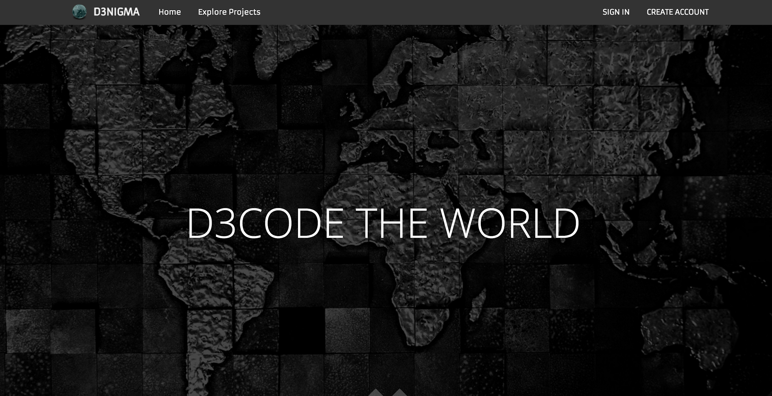
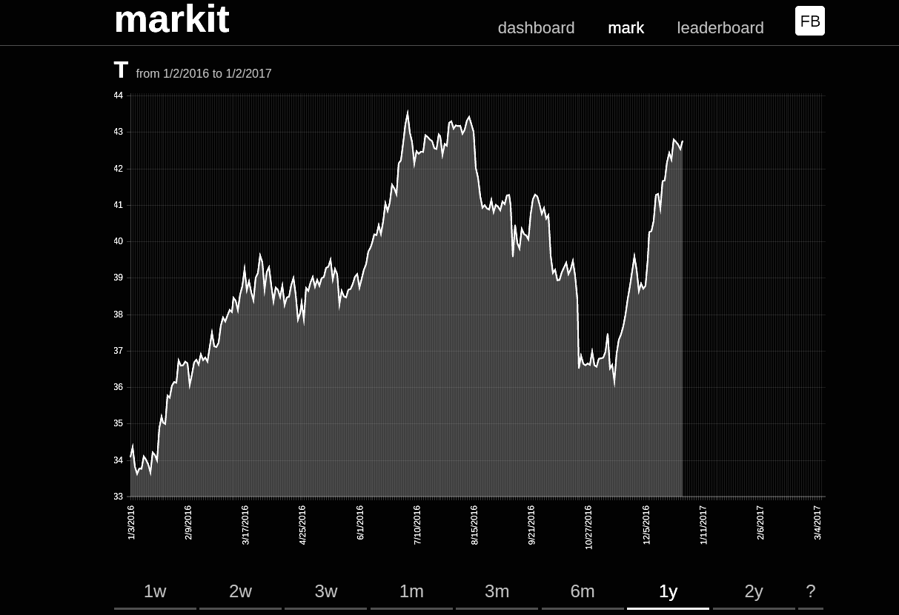
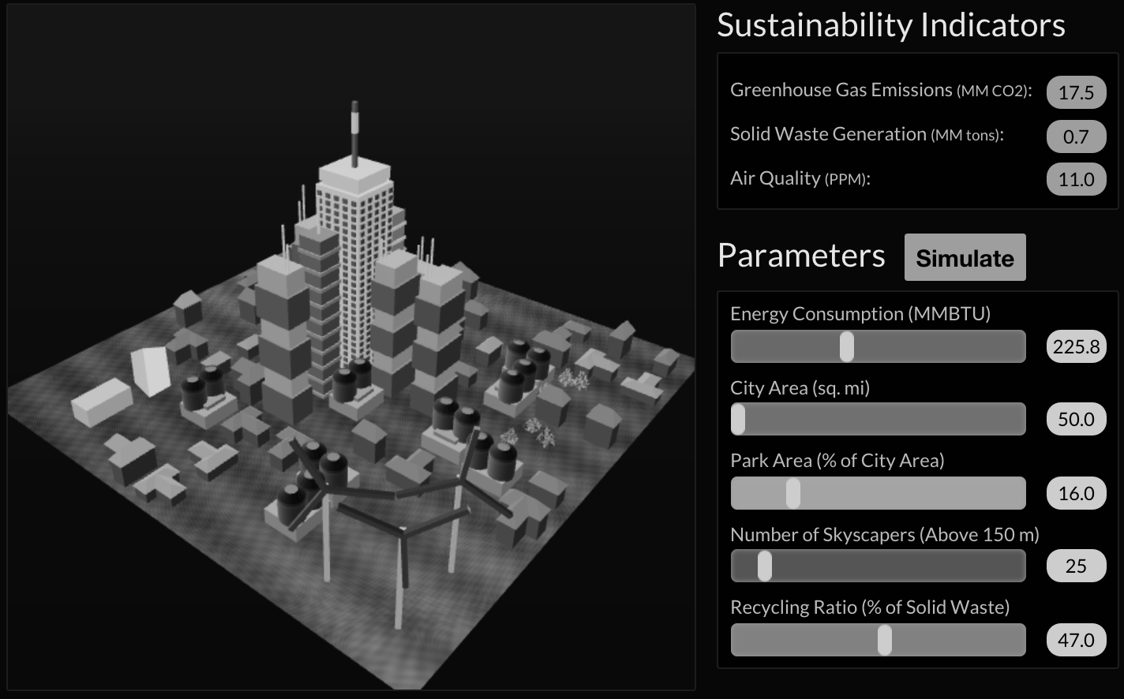
We take you end-to-end
Notes:
From server which will do all the computing in the back to making the front end display look nice and clean
Full stack

Slide 26
The world of websites is huge

Slide 27
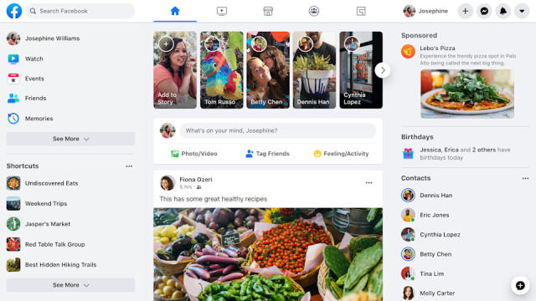
Notes:
From a simple web app like doge 2048

Slide 28
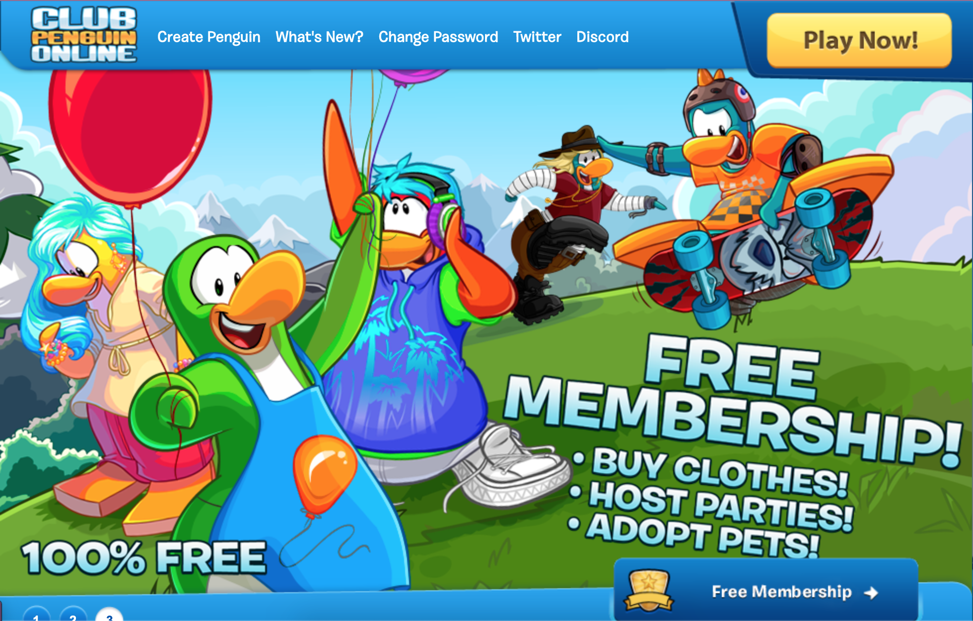

Slide 29
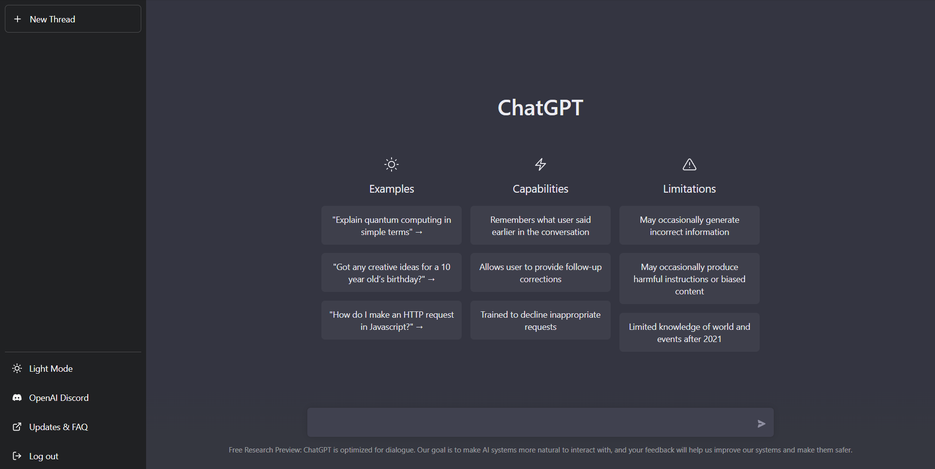
Notes:
To the complex, huge website of facebook

Slide 30
How does this all work?
Notes:
I’m going to give a brief overview of what we’re going to be learning

Slide 31
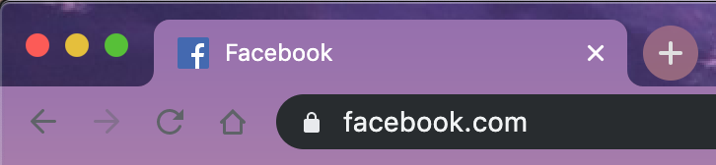
Accessing a Website

Slide 32
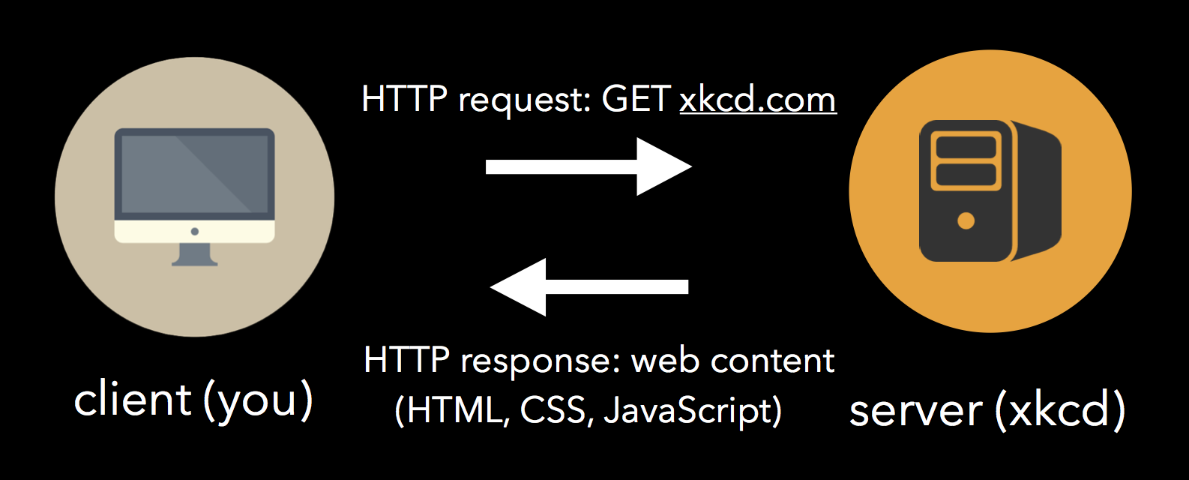
Accessing a Website
Client (you)

Slide 33
Accessing a Website
Request: GET facebook.com
Client (you)
Server (facebook)
Notes:
You will try to contact the facebook server, which is essentially a computer located at facebook

Slide 34
Accessing a Website
Request: GET facebook.com
Client (you)
Server (facebook)
Stores and serves a website
Notes:
This computer server stores and serves a website

Slide 35
Accessing a Website
Request: GET facebook.com
Response: Webpage files
Client (you)
Server (facebook)
Stores and serves a website

Slide 36
Accessing a Website
Request: GET facebook.com
Response: Webpage files
Client (you)
Program used to view a website
Server (facebook)
Stores and serves a website
Chrome

Slide 37
Webpage files

Slide 38
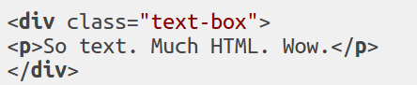
Webpage files
HTML
Notes:
HTML are the building blocks
CSS makes it look pretty
JS helps move things around

Slide 39
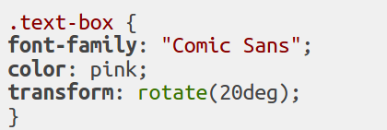
Webpage files
HTML
CSS
Notes:
HTML are the building blocks
CSS makes it look pretty
JS helps move things around

Slide 40
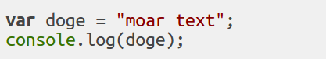
Webpage files
HTML
CSS
JS
Notes:
HTML are the building blocks
CSS makes it look pretty
JS helps move things around

Slide 41

Webpage files
HTML Assets
CSS
JS
Notes:
HTML are the building blocks
CSS makes it look pretty
JS helps move things around
You can have assets, such as this doge picture

Slide 42
What app will we build?

Slide 43
What app will we build?
weblab.is/example

Slide 44
Milestones!

Slide 45
Milestones!
Ideation MILESTONE 0 due Wed, Jan 8

Slide 46
Milestones!
Ideation MILESTONE 0 due Wed, Jan 8
Project Pitches MILESTONE 1 due Sat, Jan 11

Slide 47
Milestones!
Ideation MILESTONE 0 due Wed, Jan 8
Project Pitches MILESTONE 1 due Sat, Jan 11
Minimum Viable Product MILESTONE 2 due Wed, Jan 22

Slide 48
Milestones!
Ideation MILESTONE 0 due Wed, Jan 8
Project Pitches MILESTONE 1 due Sat, Jan 11
Minimum Viable Product MILESTONE 2 due Wed, Jan 22
Final Website! MILESTONE 3 due Wed, Jan 29

Slide 49
Milestones!
Ideation MILESTONE 0 due Wed, Jan 8
Project Pitches MILESTONE 1 due Sat, Jan 11
Minimum Viable Product MILESTONE 2 due Wed, Jan 22
Final Website! MILESTONE 3 due Wed, Jan 29
Passing the class requires completing ALL FOUR milestones!
Notes:
Passing the class will require completing all milestones. We’ll have tons of resources to help you code up your websites.

Slide 50
You must build...

Slide 51
You must build...
Dynamic website supported by a back-end

Slide 52
You must build...
Dynamic website supported by a back-end
Personalized experience based on user accounts

Slide 53
You must build...
Dynamic website supported by a back-end
Personalized experience based on user accounts
Minimum security requirements fulfilled

Slide 54
You must build...
Dynamic website supported by a back-end
Personalized experience based on user accounts
Minimum security requirements fulfilled
Original design and implementation

Slide 55
You must build...
Dynamic website supported by a back-end
Personalized experience based on user accounts
Minimum security requirements fulfilled
Original design and implementation
Use Git on a web.lab Github repo

Slide 56
You CANNOT...

Slide 57
You CANNOT...
Use anything like Drupal, Wordpress or Squarespace

Slide 58
You CANNOT...
Use anything like Drupal, Wordpress or Squarespace
Use any part of a previous project

Slide 59
You CANNOT...
Use anything like Drupal, Wordpress or Squarespace
Use any part of a previous project
Outsource your development. Hire minions.

Slide 60
You CANNOT...
Use anything like Drupal, Wordpress or Squarespace
Use any part of a previous project
Outsource your development. Hire minions.
Evil

Slide 61
Judging
Functionality technical components of your core features
Usability ease-of-use of the website
Aesthetics look-and-feel of the website
Concept Execution applicability of the solution to the problem

Slide 62
Where do we get help from?
Notes:
This class can be extremely challenging at times
So we have a bunch of super useful resources ready for you to get help from

Slide 63
Learning Resources
PIAZZA!!! POST ON PIAZZA
The Course Website weblab.mit.edu
Resources Compilation weblab.mit.edu/info
Office Hours
“Hackathon” during Week 2 + 3
Notes:
We try to respond within a few minutes
There’s always people online checking and answering questions
OH is usually monday and wednesday 7-9 pm (but check schedule for changes due to holidays, etc.)

Slide 64
Hackathon
Extended Office Hours
Try to get as much sh*t done as possible
We have generous help from staff <3 (and food/snacks/boba !!)

Slide 65
What else is there to web.lab?
Notes:
What else is there to weblab? There are a bunch of interesting topics
There’s a lot you can get out of this class whether you’re a beginner or an advanced developer

Slide 66
What else is there to web.lab?
UI Design

Slide 67
What else is there to web.lab?
UI Design
learning version control

Slide 68
What else is there to web.lab?
UI Design
a taste of course 6-3
learning version control

Slide 69
What else is there to web.lab?
UI Design
a taste of course 6-3
a first experience in creating something
learning version control

Slide 70
What else is there to web.lab?
UI Design
a taste of course 6-3
And much more!
a first experience in creating something
learning version control

Slide 71
Most importantly...

Slide 72
web.lab is not a classic MIT class
Notes:
NOT an MIT class.
It’s P/F (if you meet the requirements for the milestones and submit them on time, you’ll pass)
We are not forcing you down a strict path.
You can make whatever interests you and put as much time as you want
We as course staff are very actively involved in making this class as interesting and enjoyable for you
We will send out feedback forms every day
We will have a live Q&A doc during lectures and workshops
We will have a piazza. We try to get average response time under 5 minutes!
Strongly recommend coming to lecture
We work on an app together. Starting today and building up every day until this friday we will be working together to build an app from scratch
Second week there will be a lot of great sponsor lecture about relevant industry topics
We also as staff will be teaching more advanced topics in React, more complicated ways to layout a website, live sockets, and a bunch of interesting other topics so stay tuned!

Slide 73
THEME!

Slide 74
Theme...
2015 Theme Around the World
2016 Theme Remember the Future
2017 Theme Beyond the Horizon
2018 Theme Back to the Roots
2019 Theme Press Any Key to Start
2020 Theme Craft your own ____
2021 Theme Tag yourself
2022 Theme Imagine
2023 Theme U & I
2024 Theme Send It or Blend It
2025 Theme ???
Notes:
The theme is not supposed to be limiting in any way

Slide 75
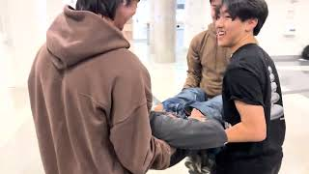

Slide 76
Branch Out

